Slide 1

UIUC Capstone Ensemble Learning and Reinforcement Learning
for Energy Demand Prediction
Hanliang Jiang,
Mentor: Julio Massignan,
Mentor: Ashmin Mansingh

Slide 2
Introduction
Dataset Abstract
Dataset Preprocessing
Data visualization
Data Augmentation
Model Ensembling

Slide 3
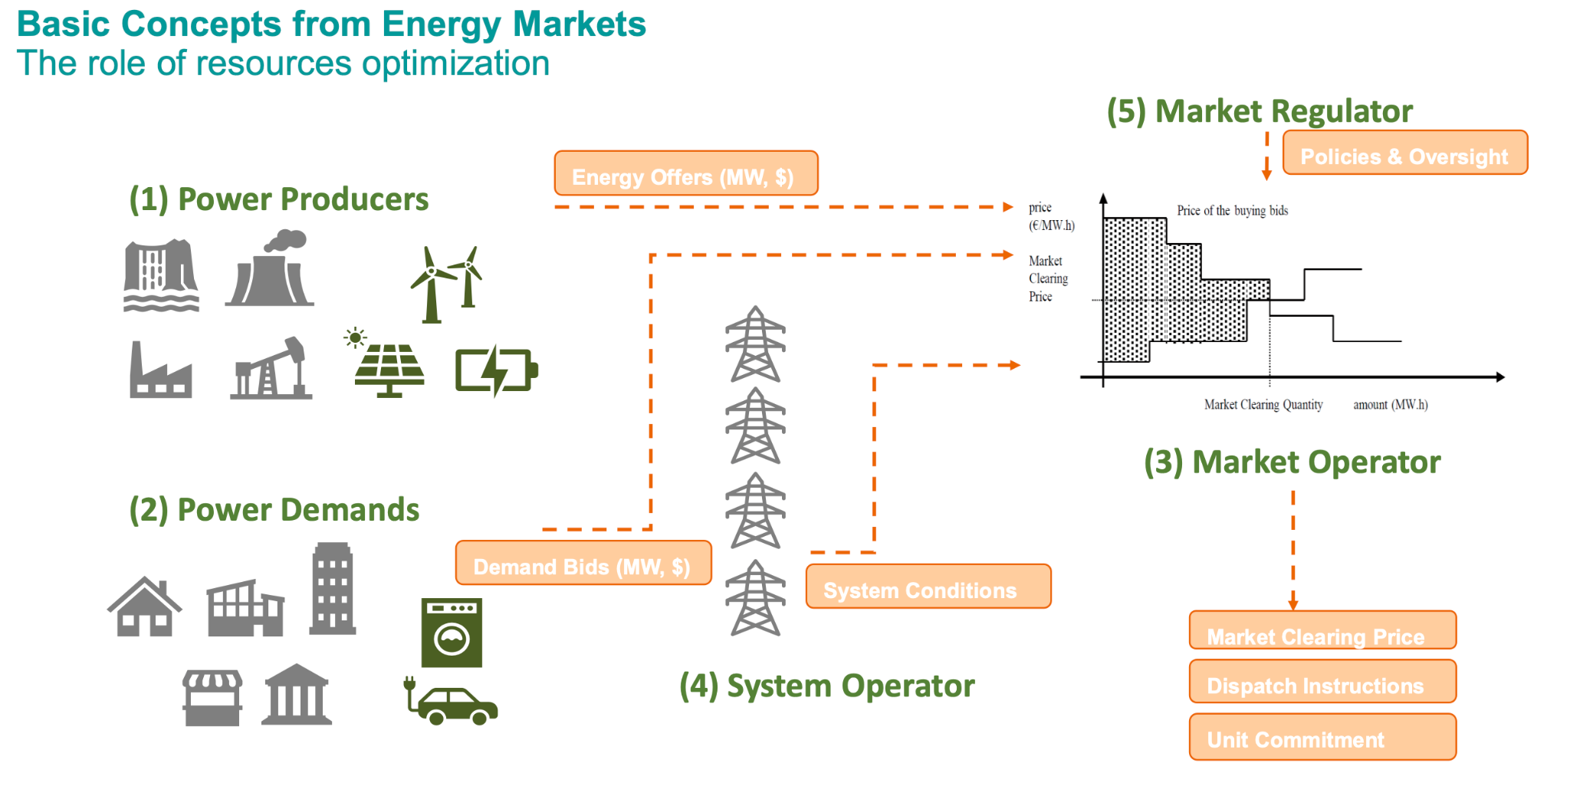
CAISO (California Independent System Operator)

Slide 4
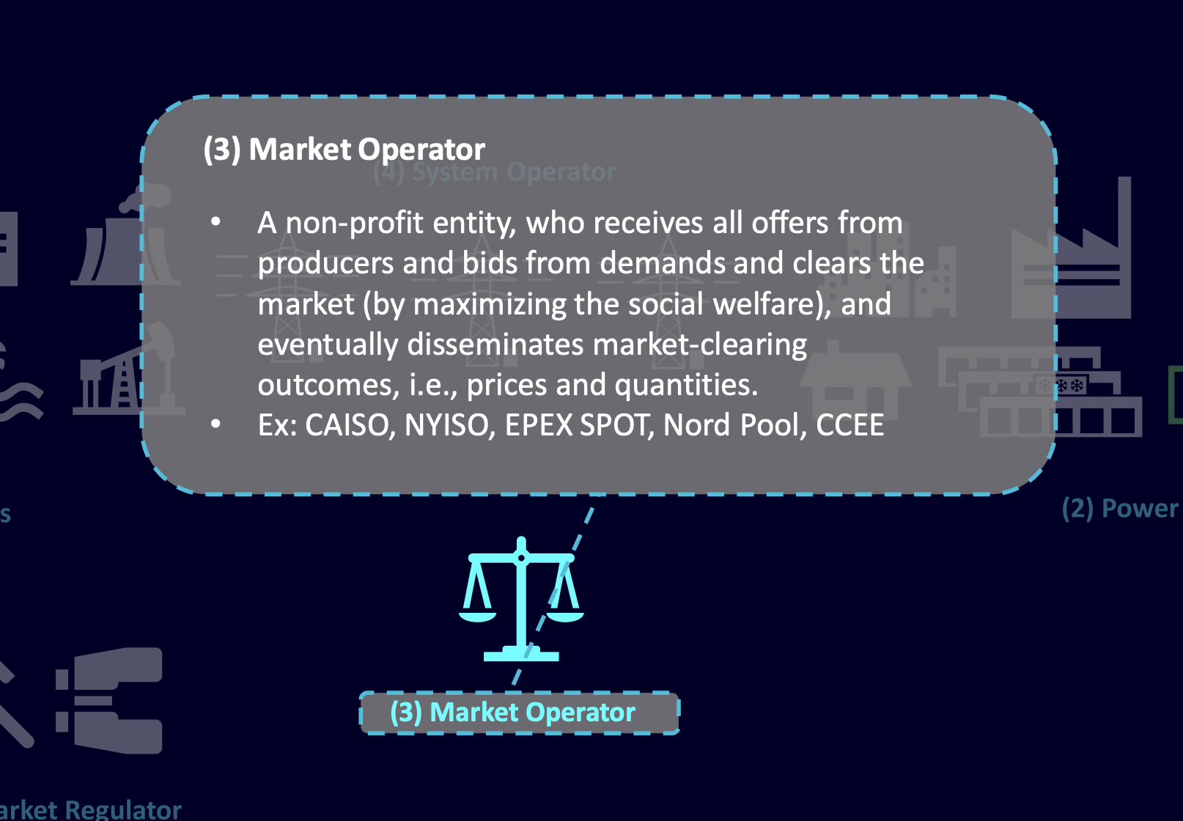
CAISO (California Independent System Operator)

Slide 5
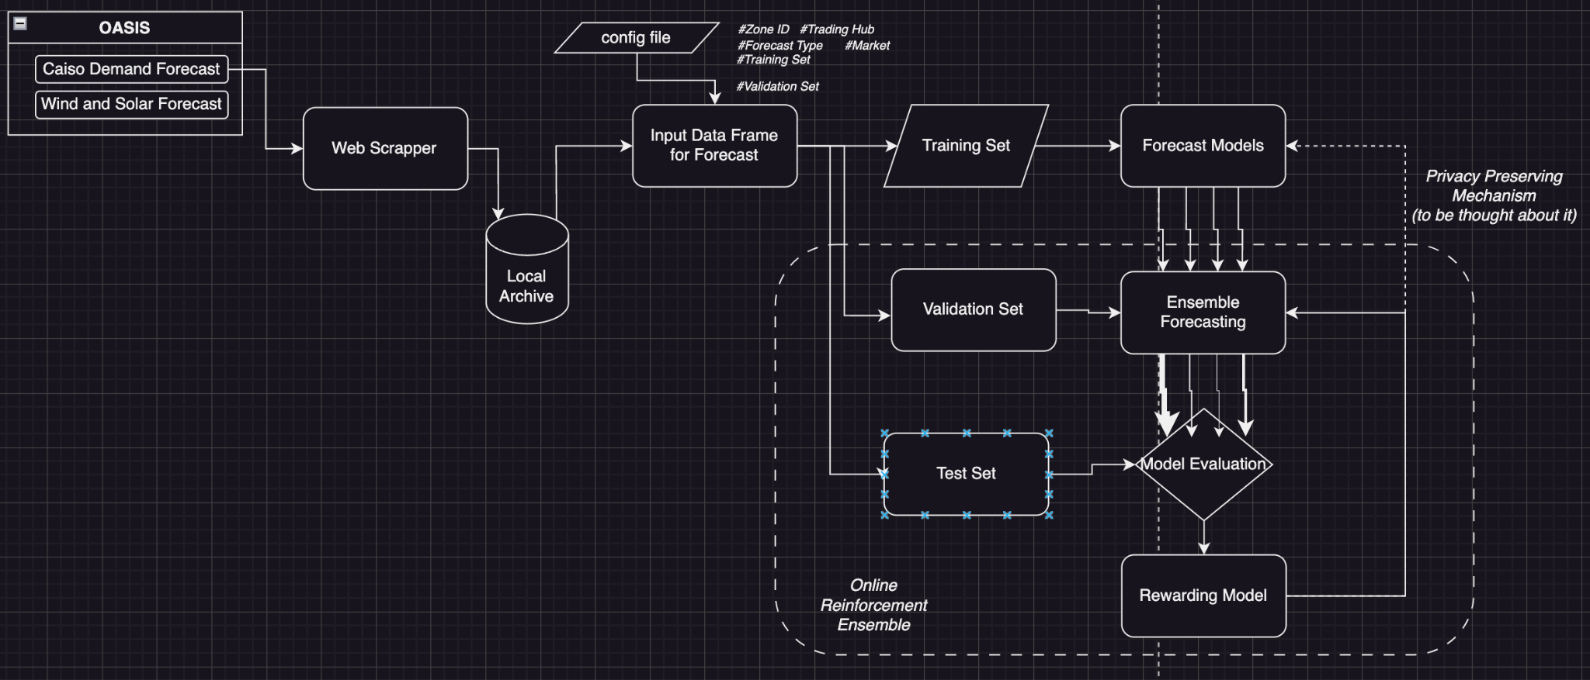
Overall Plan for demand forecasting
Notes:
This objective includes both short-run elements (least-cost daily production) and long-run elements (induce efficient investment decisions)

Slide 6
Introduction
Dataset Abstract
Dataset Preprocessing
Data visualization
Data Augmentation
Model Ensembling

Slide 7
CAISO Dataset
DAM: Day Ahead Market
ACTUAL: Ground Truth Data
RTD: Real Time Dispatch
RTPD: Read Time Pre-Dispatch

Slide 8
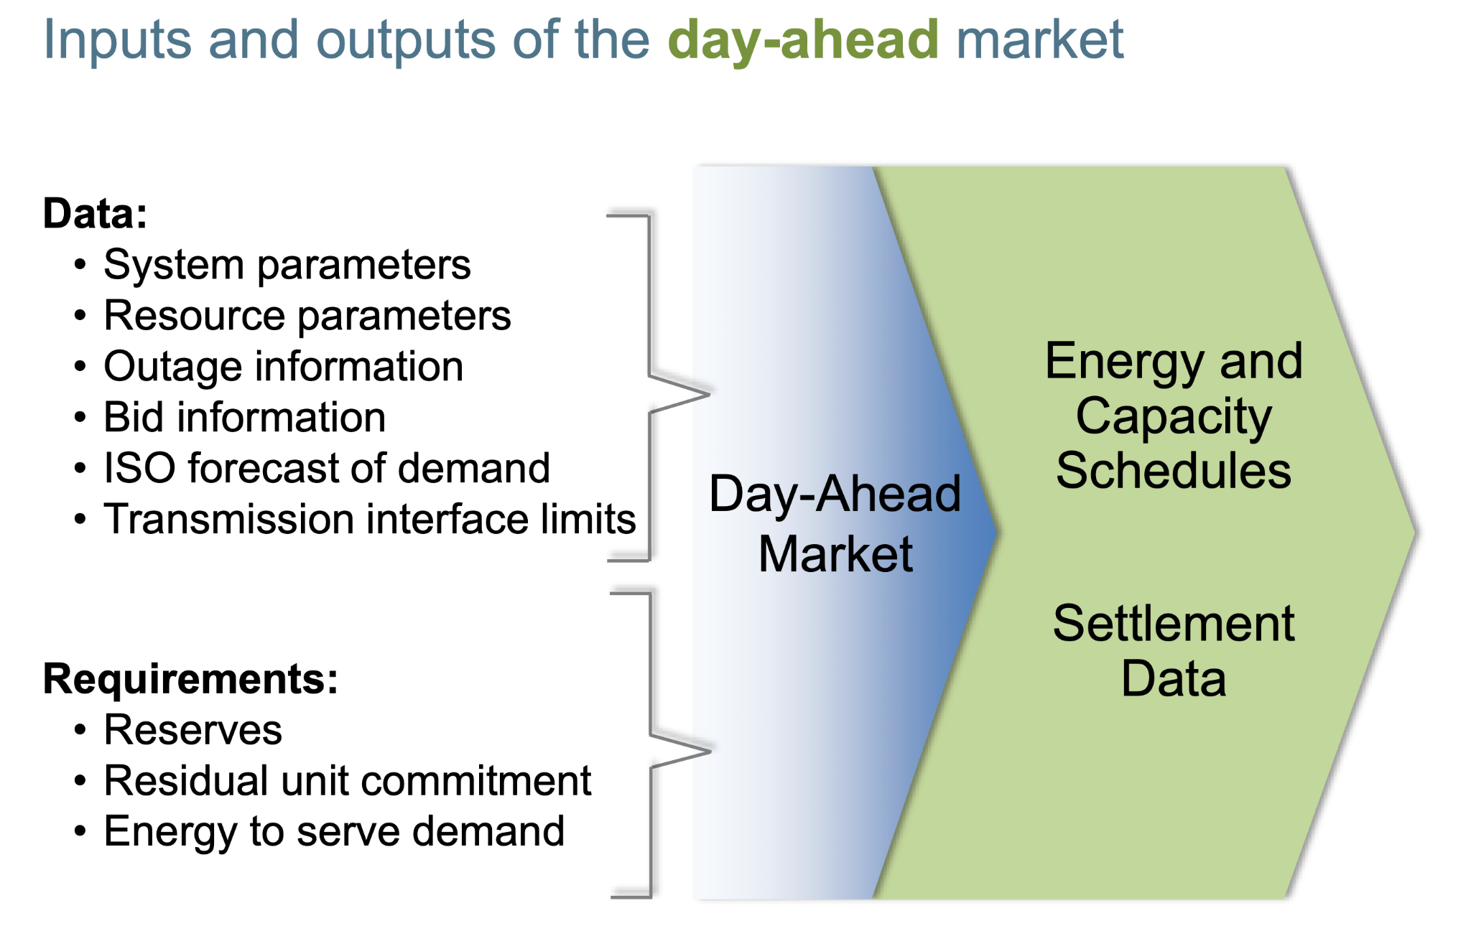
DAM: Day Ahead Market

Slide 9
Introduction
Dataset Abstract
Dataset Preprocessing
Data visualization
Data Augmentation
Model Ensembling

Slide 10
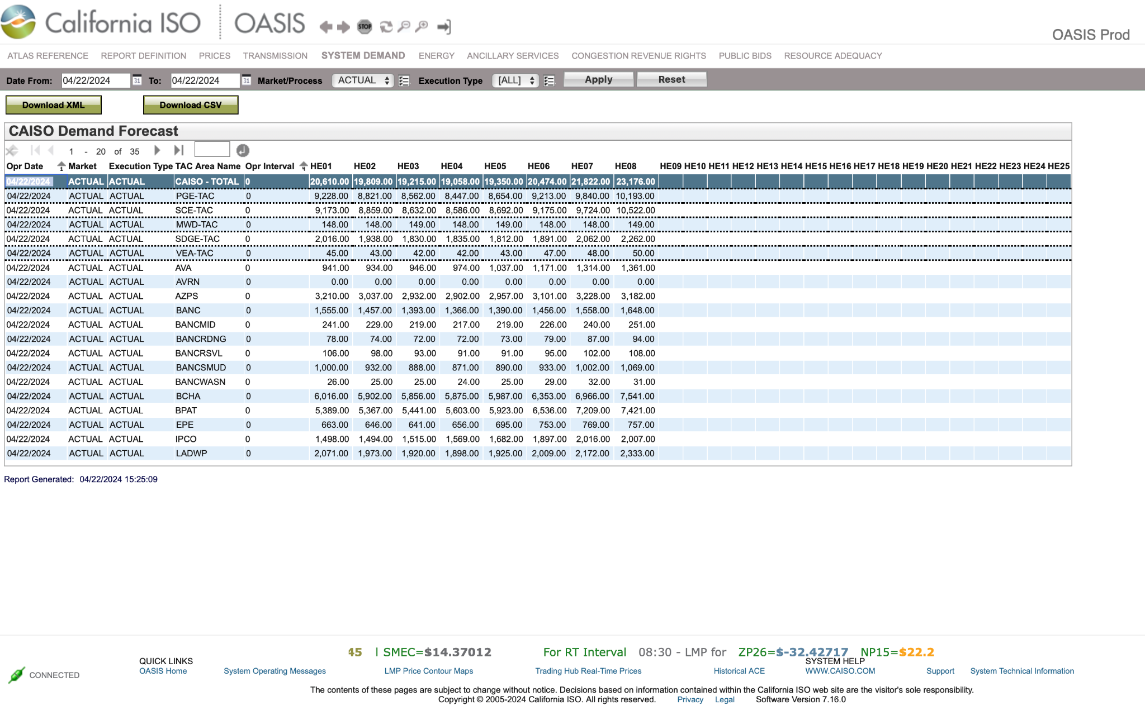
CAISO (California Independent System Operator)

Slide 11
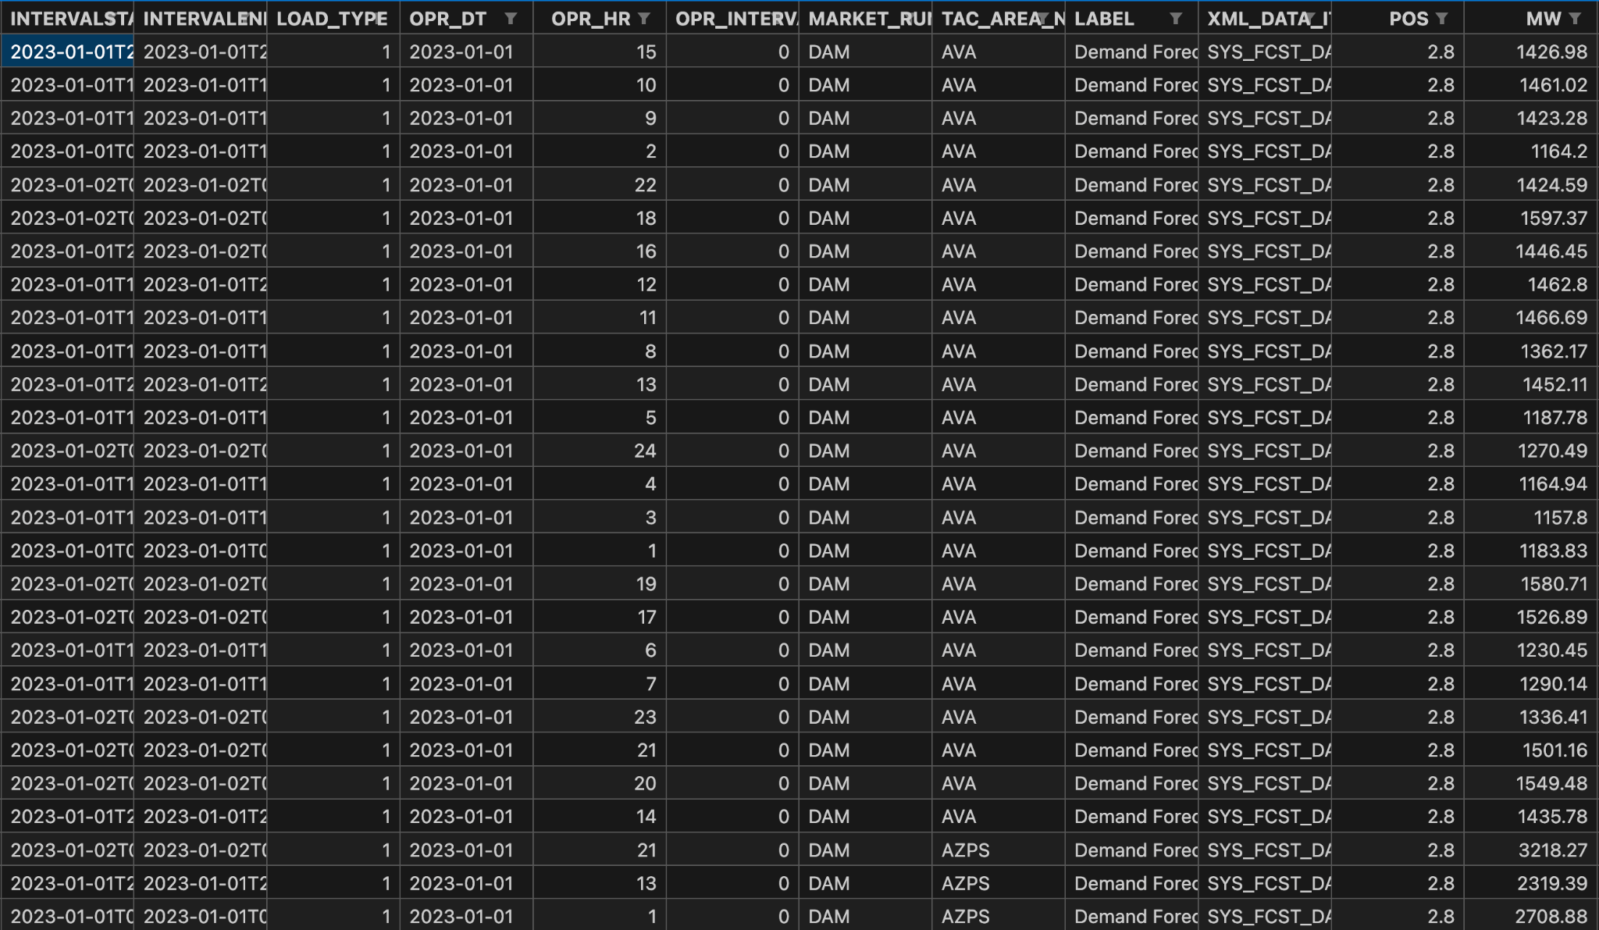
CAISO (California Independent System Operator)

Slide 12
Dataset split
Training set: Jan 1st, 2023 – July 1st, 2023
Validation set: July 1st, 2023 – August 1st, 2023
Test set: August 1st, 2023 – August 20th, 2023

Slide 13
Introduction
Dataset Abstract
Dataset Preprocessing
Data visualization
Data Augmentation
Model Ensembling

Slide 14
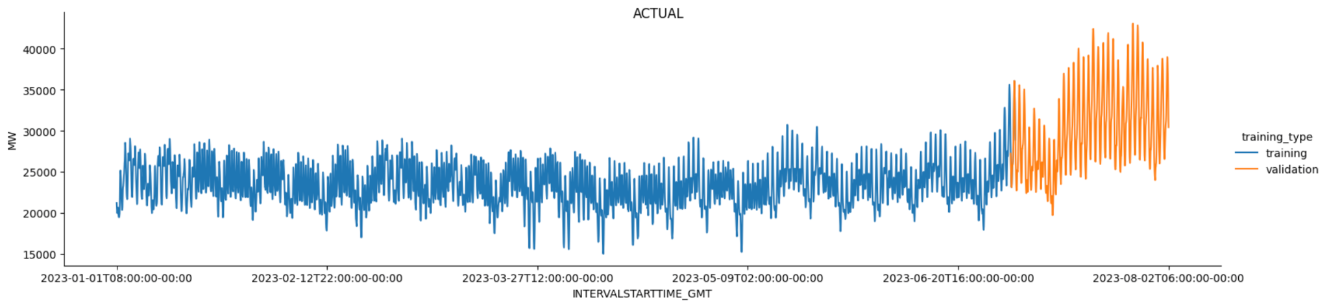
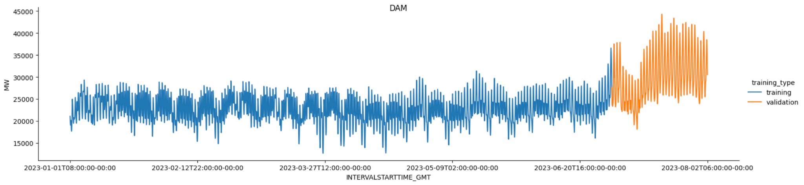
Day Ahead Market

Slide 15
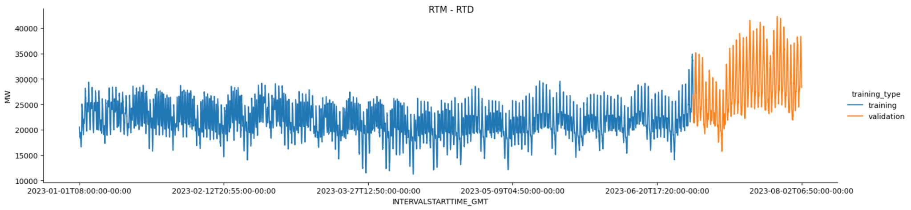

Real Time Market

Slide 16
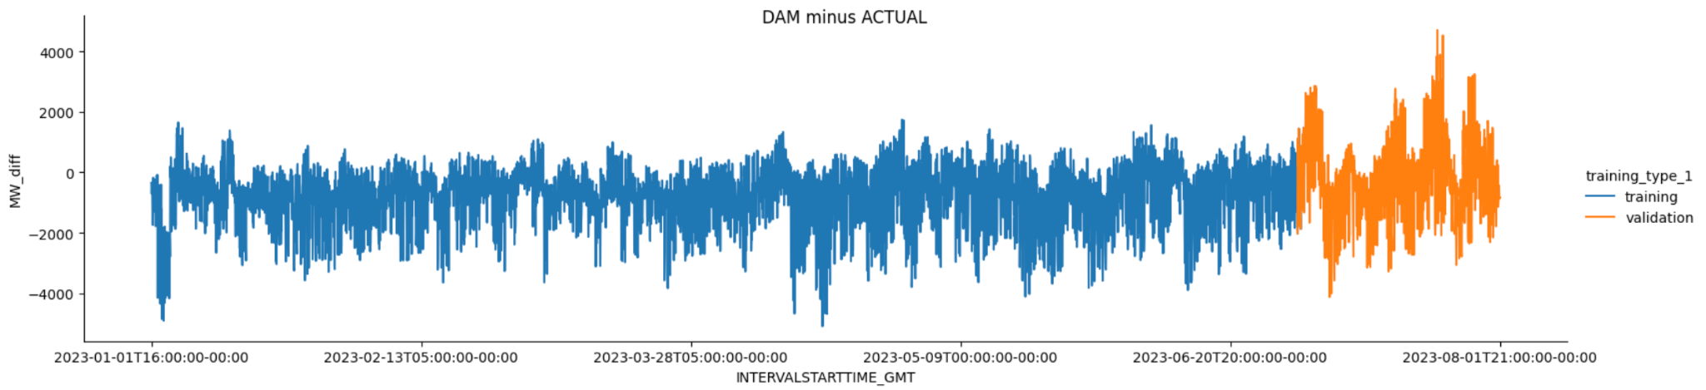
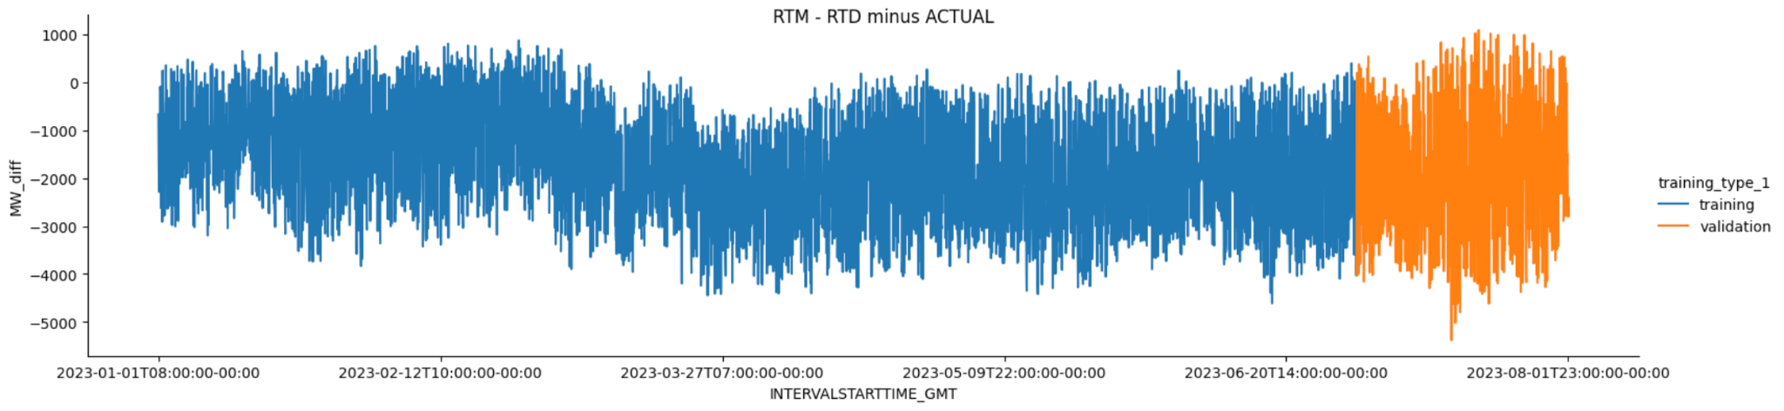
CAISO Prediction Bias

Slide 17
Introduction
Dataset Abstract
Dataset Preprocessing
Data visualization
Data Augmentation
Model Ensembling

Slide 18
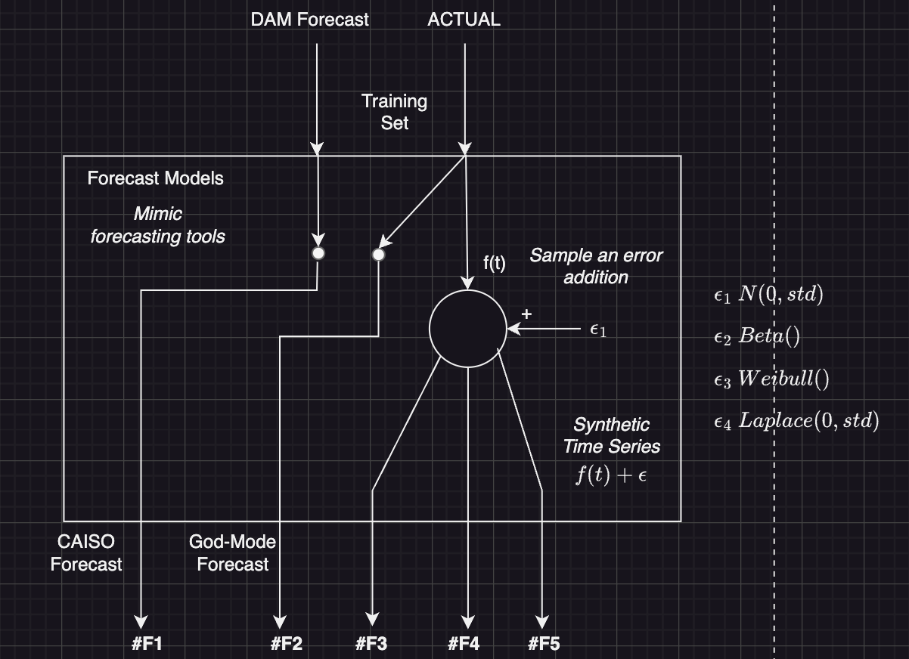
Data Augmentation

Slide 19
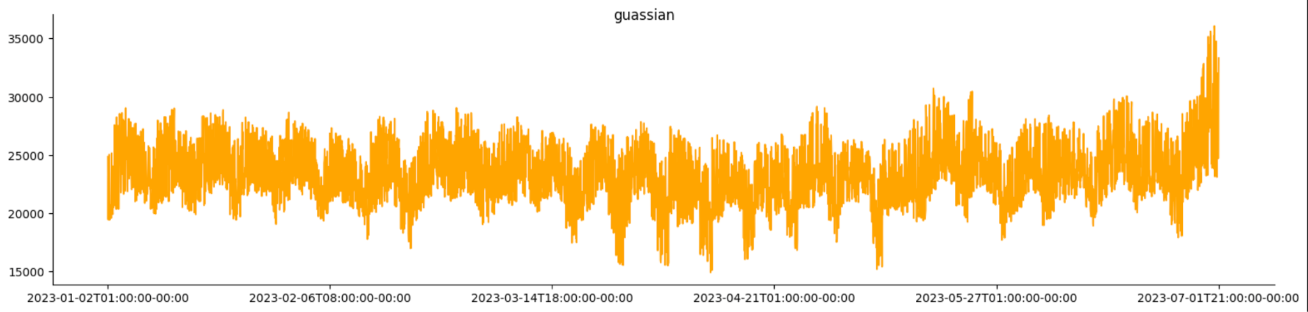
Data Augmentation: Gaussian Noise

Slide 20
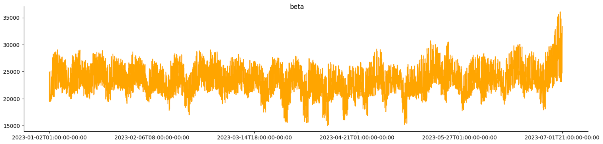
Data Augmentation: Beta Noise

Slide 21

Data Augmentation: Weibull Noise

Slide 22

Data Augmentation: Laplace Noise

Slide 23
Introduction
Dataset Abstract
Dataset Preprocessing
Data visualization
Data Augmentation
Model Ensembling

Slide 24
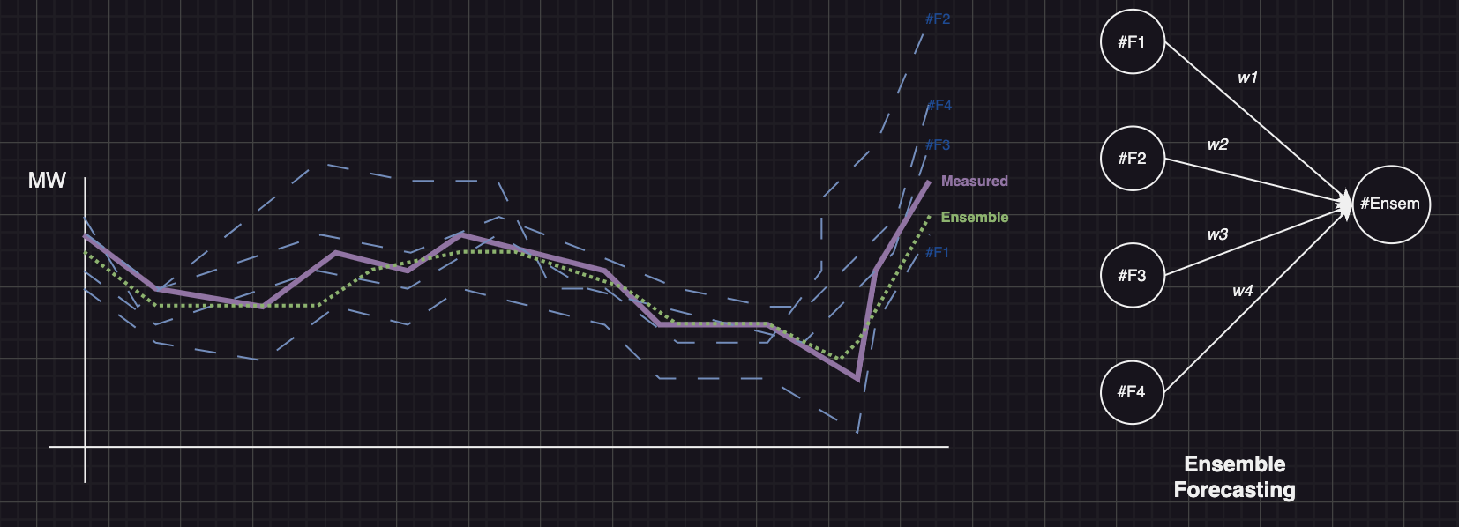
Model Ensembling

Slide 25
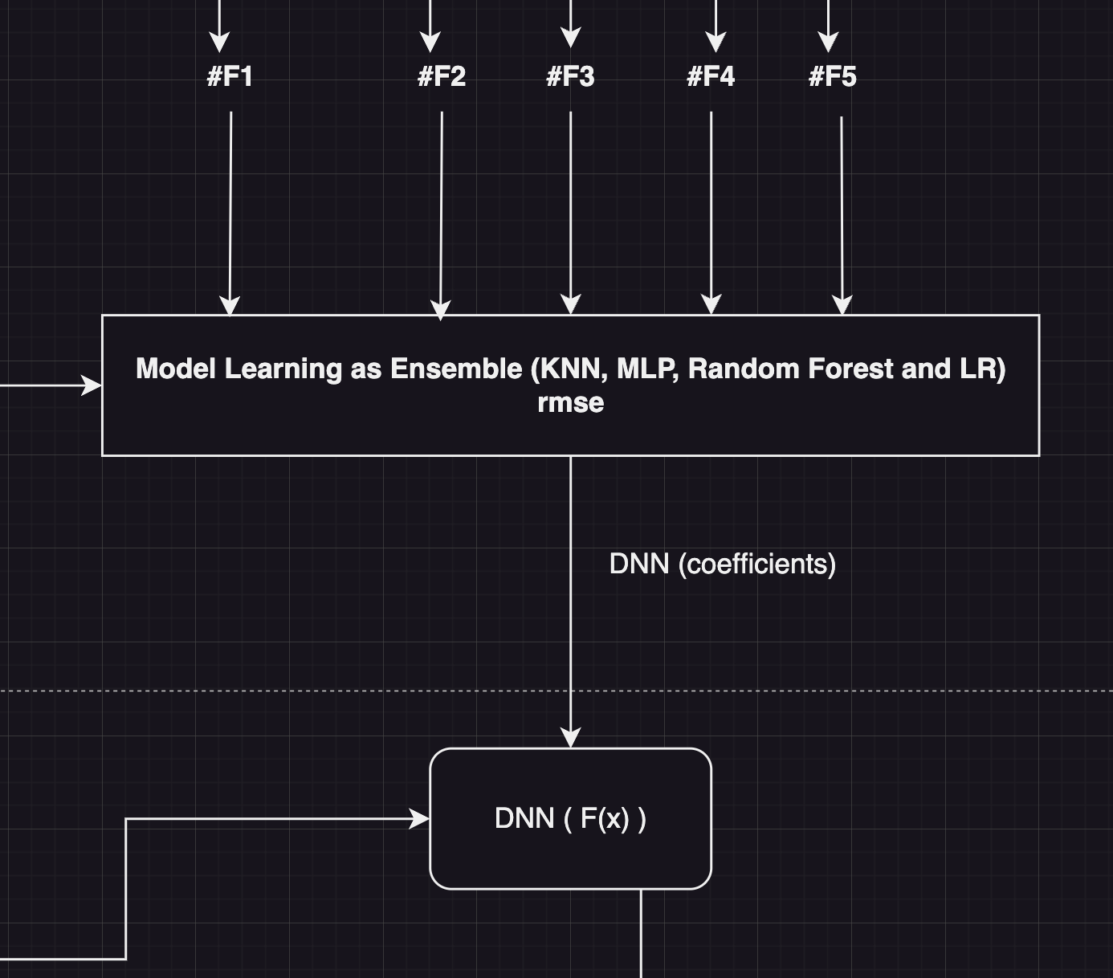
Model Ensembling

Slide 26
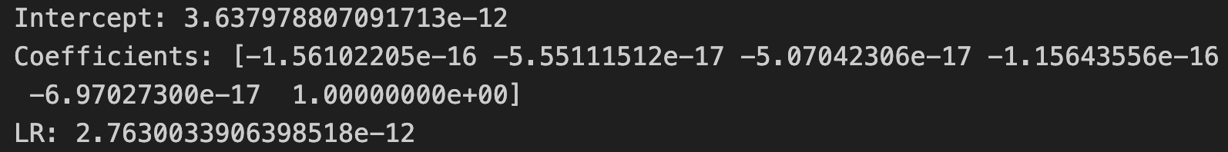
Linear Regression with Actual Values as a feature: Parameters

Slide 27
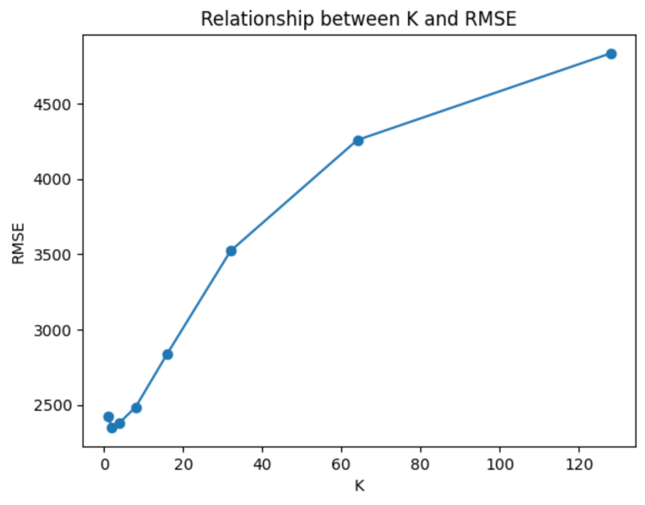
K Nearest Neighbors: Tuning Hyperparameters

Slide 28
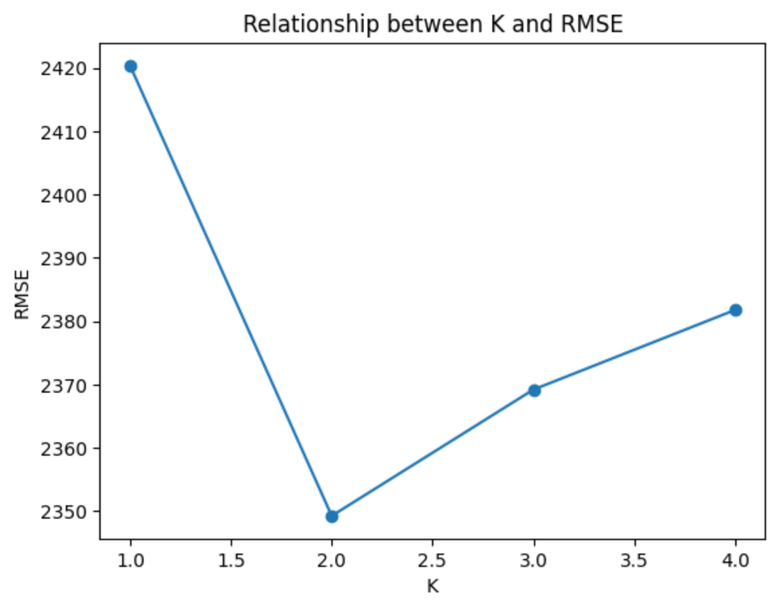
K Nearest Neighbors: Tuning Hyperparameters

Slide 29
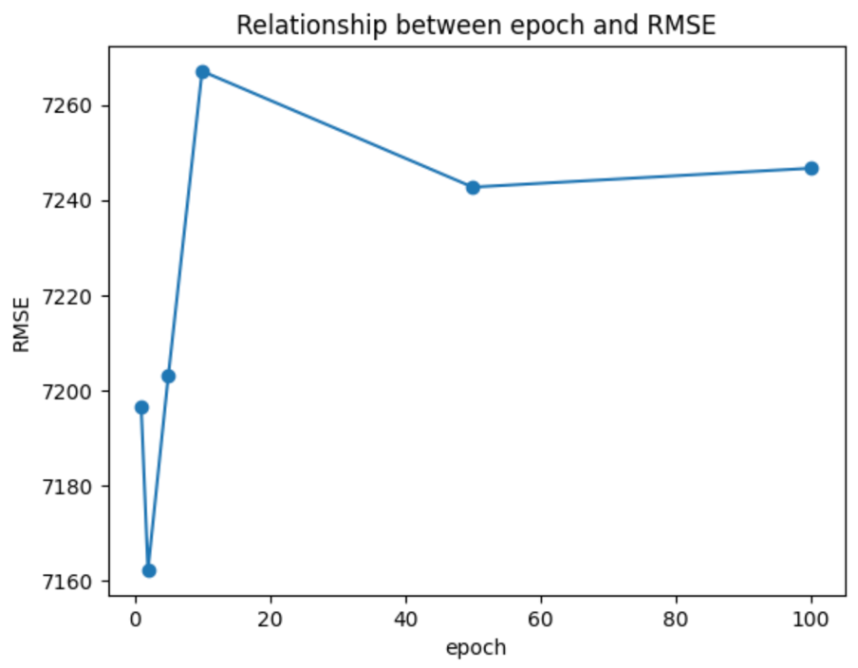
Multilayer Perceptron: Tuning Hyperparameters

Slide 30
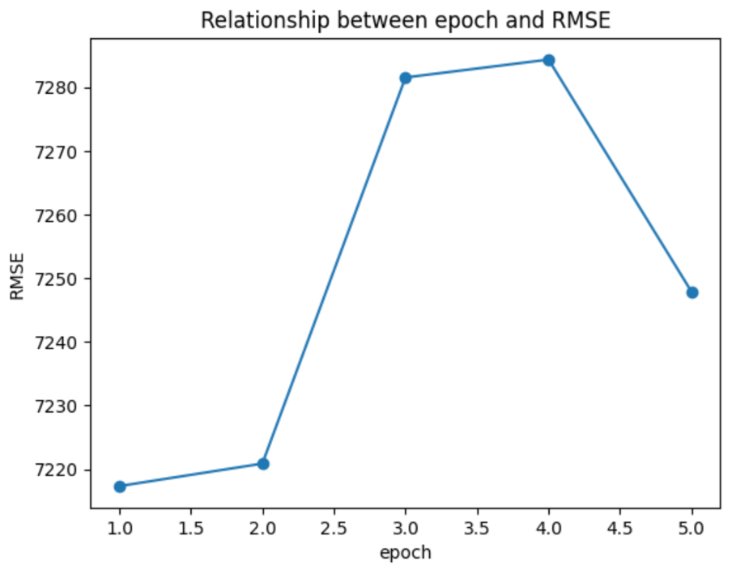
Multilayer Perceptron: Tuning Hyperparameters

Slide 31
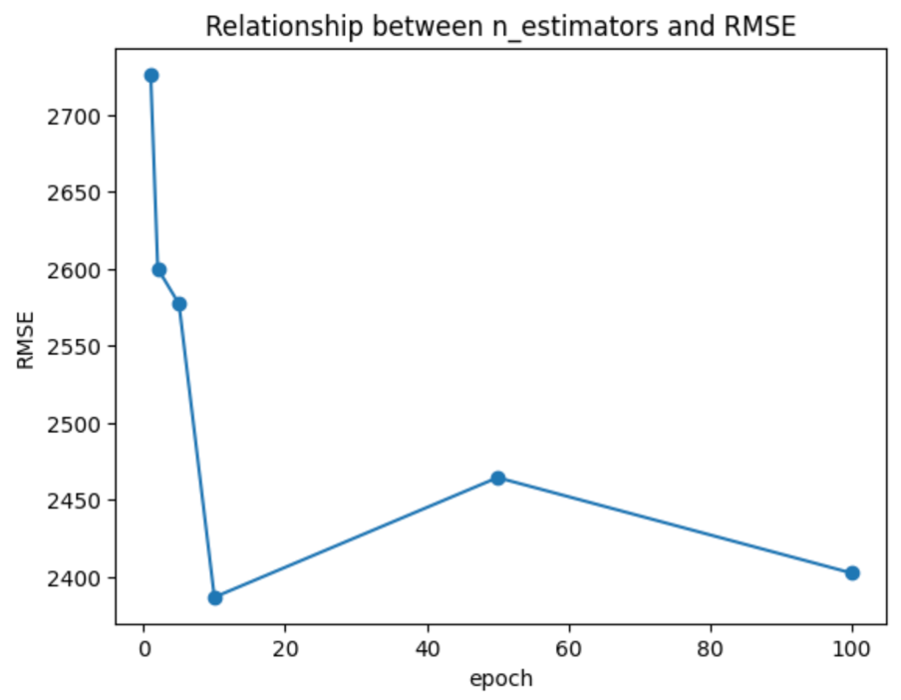
Random Forest: Tuning Hyperparameters

Slide 32
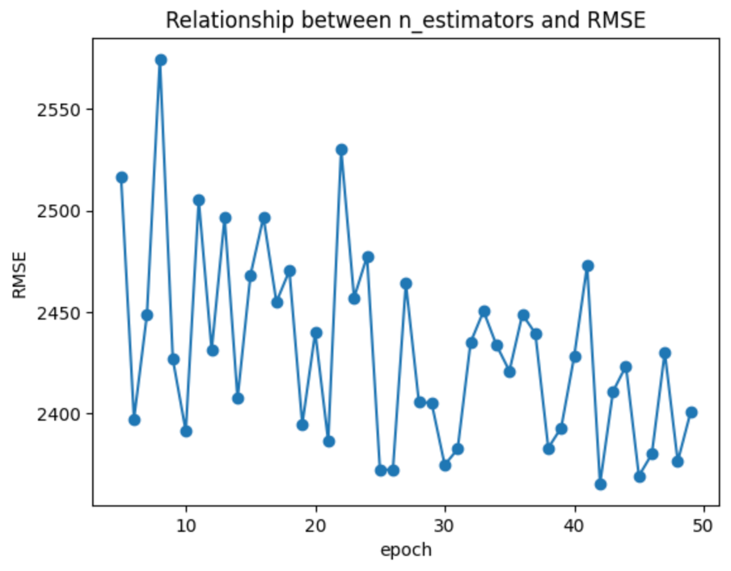
Random Forest: Tuning Hyperparameters

Slide 33
Linear Regression: Parameters

Slide 34
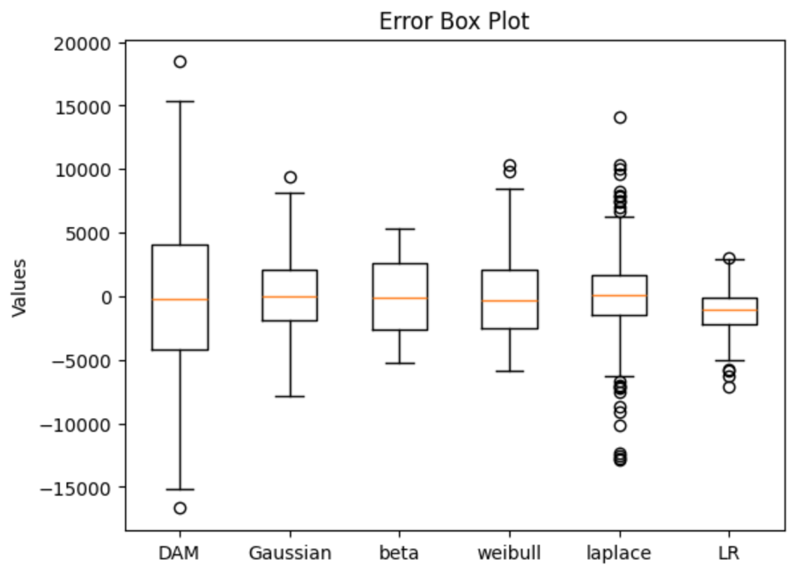
Error compared with single models

Slide 35
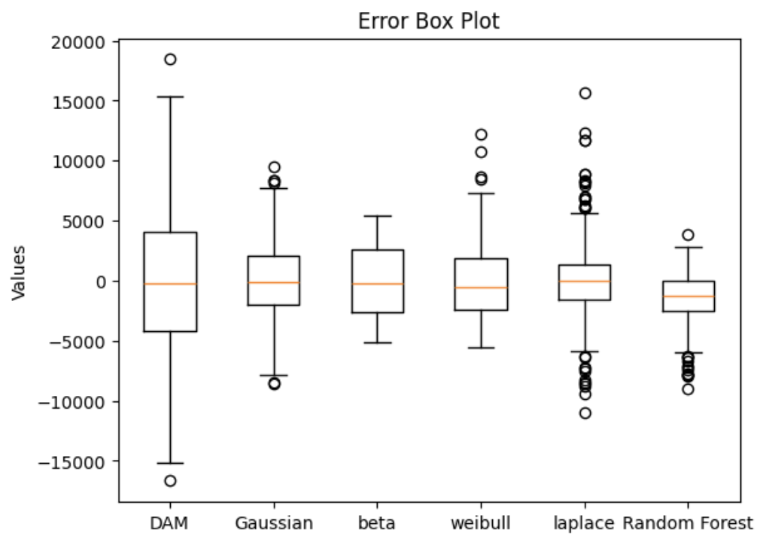
Error compared with single models

Slide 36
Conclusion
In this research project, we explore the whole procedure of deploying and optimizing machine learning models for increasing prediction accuracy, by experimenting with data processing and machine learning methods, we improved the accuracy of the power demand forecasting.

Slide 37
Future work
Reinforcement learning methods
Combining with data markets
Real world CAISO model improvement

Slide 38
Thank You

